Slide 1
Financial Analysis on Dell Technologies Inc.
Group No. 08
Section 04
Chintan Wagh -0788995
Devashish Patel - 0781214
Jervis Murzello - 0784028
Omkar Kirankumar Shinde- 0785564
Urvashi Prajapati -0785750

Slide 2
Table of Contents
History of Dell
Dell’s Products and Services
Dell’s Mergers and Acquisitions
Introduction
Fundamental Analysis
CAPM
Ratio and Valuation Analysis
Monte-Carlo Simulation
Bollinger Bands
Facebook Prophet
Stock Signals
Recommendations

Slide 3
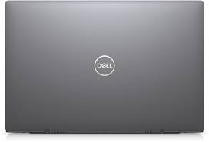

History of Dell
Origins
Dell’s origin started as a belief and passion: that everybody should have easy access to the best technology anywhere in the world. This started out in 1984 in a place that was Michael Dell’s (Chairman & CEO) dorm room. Today, Dell Technologies is instrumental in changing the digital landscape the world over.

Slide 4
Products & Services
Dell offers many solutions for IT infrastructure, workforce, industry and OEM.
1) IT infrastructure solution:
APEX delivers complete IT infrastructure solutions for a range of data and workload requirements, enabling you to accelerate innovation, adapt to evolving requirements and stay in control of IT operations.
2) Dell also provides security Solutions along with the IT infrastructure.
3) Their infrastructure solutions include many services like AI, Analytics, VMware, Validated designs, etc.
4) Their Workforce solutions include many services like Endpoint Security, AI Workstations, Optimizer Intelligence etc.
5) Their Industry solutions are spread across different industries like Healthcare and Life Sciences, Digital solutions, Retail, etc.
6) Along with this they also offer specific OEM solutions in collaboration.

Slide 5
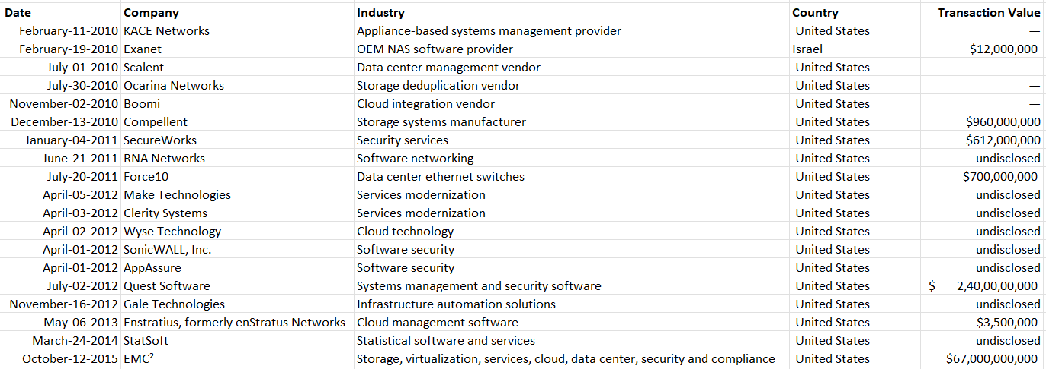
Mergers and Acquisitions
Shown below are Dell’s latest mergers and acquisitions from 2010 to present. EMC² and Quest Software are their biggest acquisitions so far in this time period.

Slide 6
Introduction
Our aim is to determine whether a trader or any person should buy, sell or hold the stock of Dell Technologies Inc.
For the sake of comparative evaluation, we have used S&P 500’s data as the other company data available on NASDAQ.
Following are the tools that we used to perform the financial analysis:
CAPM
Ratio and Valuation Analysis
Monte-Carlo Simulation
Bollinger Bands
Facebook Prophet

Slide 7
Fundamental Analysis
Market Cap : 32.139 Billion US $
Current Market Share (Q1 2022): 17.7%
Total Revenue: 104.723 Billion US $
Net Sales: 101.2 Billion US $
Gross Profit: 20.14 Billion US $
Total Assets: 92.74 Billion US $
Total Liabilities: 94.32 Billion US $
Earning per Share: 7.3 $

Slide 8
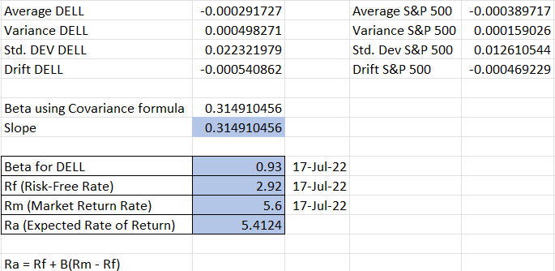
Capital Asset Pricing Model (CAPM)
We have performed CAPM analysis for Dell in comparison with S&P 500 data from NASDAQ.
The beta value for DELL (from Yahoo finance) is 0.93 and the value we calculated in Excel is 0.315.
As we can see the expected rate of return of DELL is 5.4124.

Slide 9
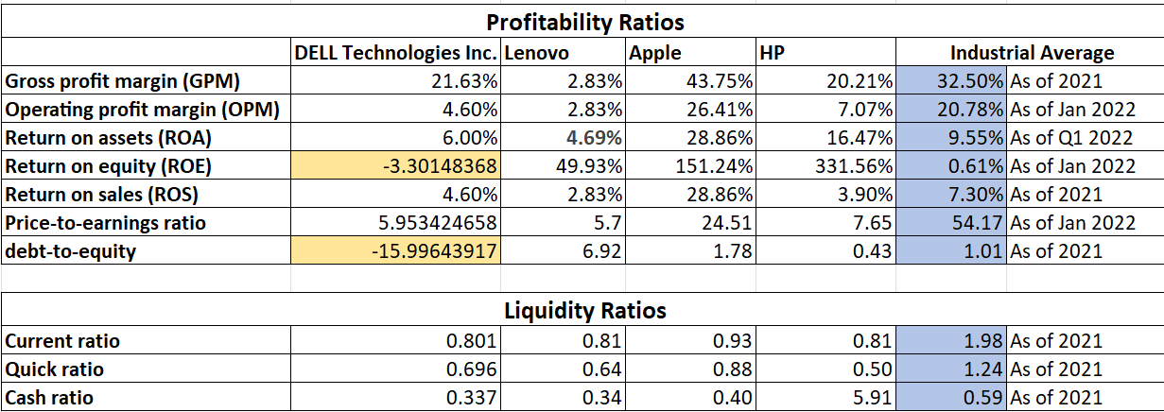
Ratio and Valuation Analysis
Given below is the ratio and valuation analysis of Dell compared to its main competitors like Lenovo, Apple and HP. We can also see the Industrial Average along with these ratios. We can see that Dell is performing very poorly as compared to the other companies as well as the Industrial average.

Slide 10
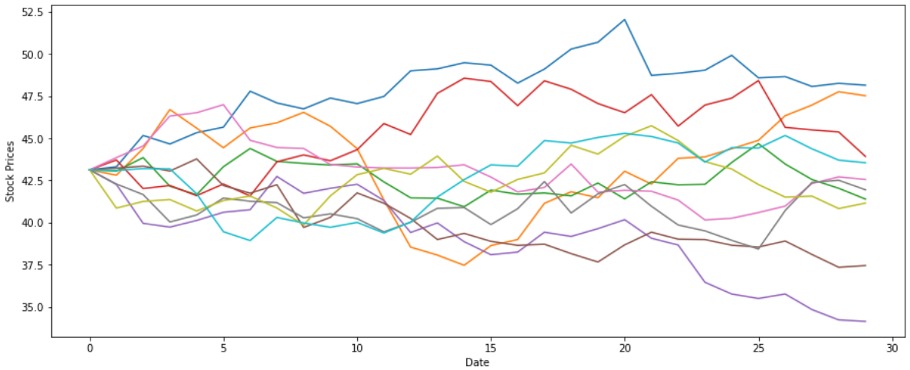
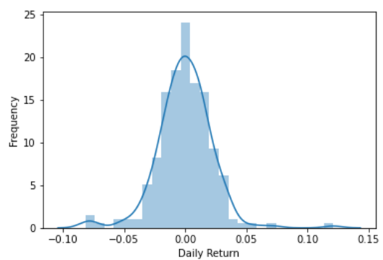
Monte-Carlo Simulation
Monte Carlo Simulation is used to forecast the future prices of a stock based on the prices of the past. It can also include seasonality.
The images given below show the Dendrogram of the daily returns of Dell along with the Monte Carlo simulations of the stock prices for the next 30 days.
We can see that the highest stock price is greater than 46 and lowest stock price is less than 34.

Slide 11
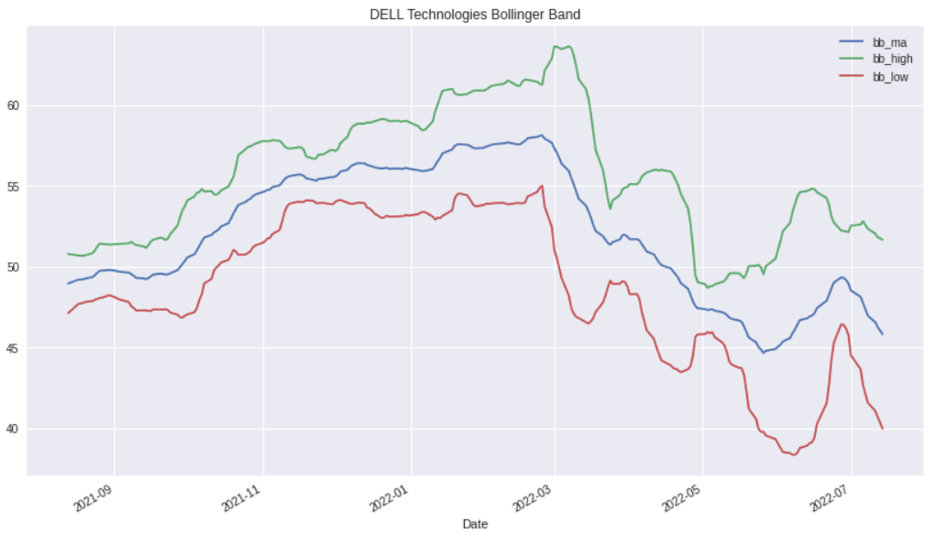
Bollinger Bands
In the month of July 2022, we can see that the lower band is closer to the moving average. This means that the stock is performing poorly and is likely to go down in the future.

Slide 12
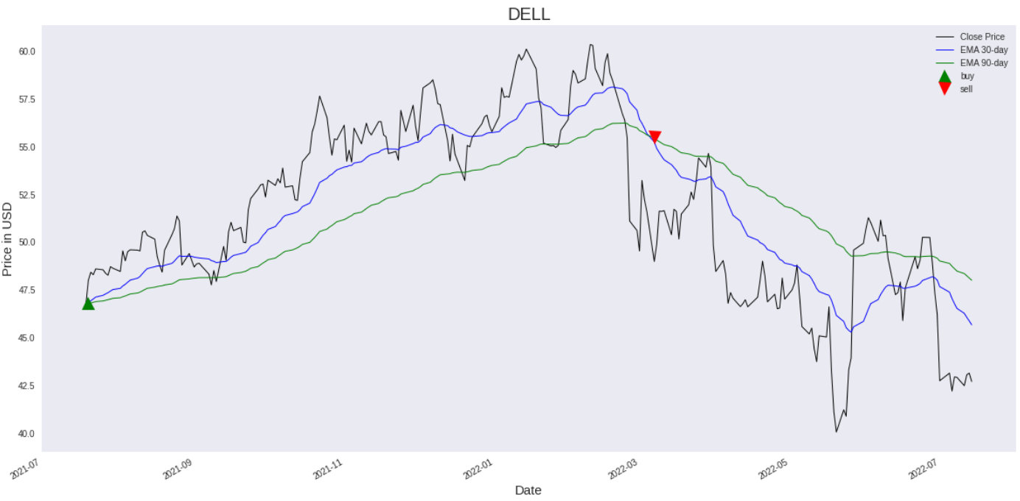
Stock Signals
The graph given below shows the stock signals suggesting a trader to buy and sell respectively based on the stock prices. For comparison, we have used the Exponential moving average of a 30 days and 90 days periods.

Slide 13
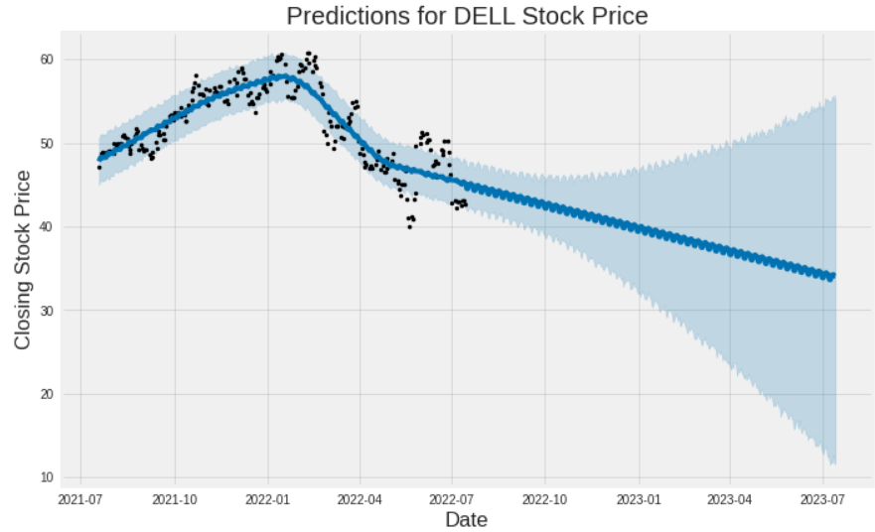
Facebook Prophet
The Facebook prophet library predicts that the stock price is falling. The observed trend is shown in the graph below.

Slide 14
Recommendations
We observed that all the methods suggest one key aspect of the current status of the stock. As shown above, we could see that the stock is performing poorly. So, our recommendations are:
If a new trader is interested in the Dell Technologies Inc. stock:
Buying this stock right now has potential chances of inducing heavy losses to the trader. This is because the stock is at a low price relatively and the market changes are highly volatile, so it is difficult to predict if the stock price would rise.
2) If a trader had bought the stock previously:
Selling this stock right now seems to be the best option to cut losses and look for other potential stocks.

